Slide 1
Survival Analysis of Mortgage Data
Peter Trubey

Slide 2
Background
Mortgages – Loans made using a property as collateral
Fixed Rate – The Interest Rate can not change over time
Adjustable Rate – The Interest Rate can change over time
Foreclosure – The Credit Backer repossesses the house
Problems
Heavily affected by Economy
Confounding effects If we want to generalize to other time periods

Slide 3
Background (Cont.)
30-year Fixed Rate Mortgages
Originating 1999 to 2012
15,000,000 Mortgages in combined dataset
Subsampled by 1% to get 150,000 observations
~ 6000 Failures
Delinquency = Failure
Treating Delinquent as more than 180 days on loan as failure

Slide 4
Data: Origination Set
Data About Loan at Time of Origination
FICO – Credit Score
DTI – Debt to Income
FTHB – First Time Home Buyer
UNITCNT – Number of Units in Dwelling
Single home vs. duplexes, multifamily homes
Occupancy
Owner occupied, second home, or investment property (rental/flipping)

Slide 5
Data: Origination Set (Cont.)
CLTV – Combined Loan to Value
Interest – Interest Rate on the Loan
Channel – Channel through which loan was purchased
Retail, Broker, Correspondent, or unknown
State – State in which Property is located
Loan Purpose
Cash-out Refinance, No-cash-out Refinance, Purchase

Slide 6
Data: Performance Set
By Month Loan Performance Data
UPB – Unpaid Principal Balance
Missing data for bulk of dataset
Repurchase Flag
At Loan Termination – Whether loan was repurchased from Freddie Mac
Also Missing data for bulk of set
Condition – Condition of Loan at end of follow-up
Paid in Full, Paid Early, Deed in Lieu of Foreclosure, 180 Days Delinquent

Slide 7
Economic Indices
Unemployment
HPI – Housing Price Index
State and National
Labor Force Participation Rate

Slide 8
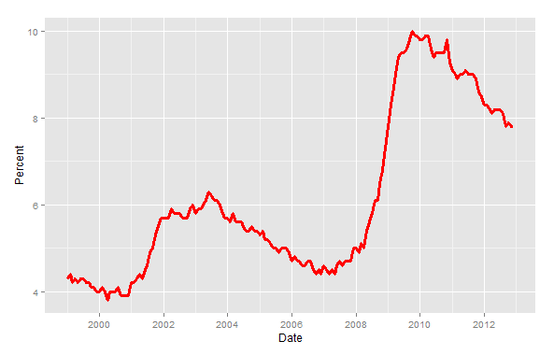
Unemployment
Unemployment Rate – as a Percentage

Slide 9
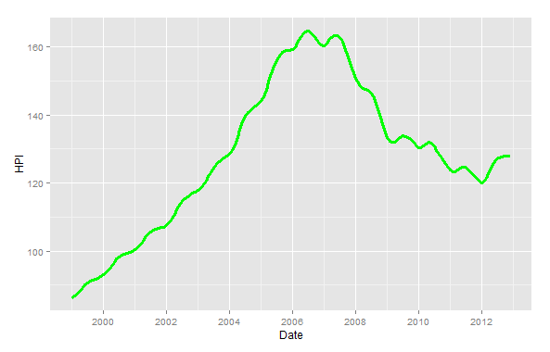
Housing Price Index
Housing Price Index – By State and National

Slide 10
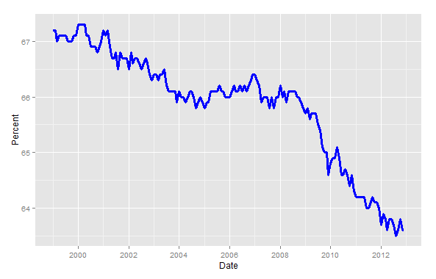
Labor Force Participation Rate
Labor Force Participation Rate – As a Percentage

Slide 11
Ground Rules for Modeling
Goal: A Succinct Model / Small Number of Predictors
Difficult to achieve with a large dataset
All transformations will appear as significant, even if they’re worthless for modelling
Limit Macroeconomic Indicators
Try to make model generalizable beyond this time period
Automated Variable Selection won’t be of much help

Slide 12
Methodology
Data Stored in By-Quarter Text Files (1999-2012)
Separate files for Origination Data and Performance of Loan
Performance Data in Counting Process Format by Month
Read Data in. Subsample 2% of Data
1 % to train, 1% to validate
Merge in Economic Data
Break Time into Periods (6 month, 4 month, 3 month)
Counting Process – ( start , end ]
Cox Proportional Hazards Model $h\left(t | Z\right)=h_{0}\text{(}\text{t}\text{)}\text{exp}\text{(}β\text{’}Z)$

Slide 13
Models
Model 1:
Using raw values for Economic Effects, All variables not previously removed
Scaling relevant numerical observations
Model 2:
Using Transformed Economic Effects – Difference between observation time and start of loan
Model 3:
Expansion of Model 2
Use transformation of Interest, relative to Baseline Interest Rate at loan origination time

Slide 14
Model 1 Results
Removed Variables From Model:
First Time Home Buyer
Housing Price Index – National
Log Likelihood of Model 1 : -54126.54
Dissatisfied with using raw economic indicators in model
Search for Transformations

Slide 15
Model 1 Coefficients
Variable | coef | exp(coef) | se(coef) | z | Pr(>|z|)
unemp | 0.524181 | 1.6890745 | 0.0142829 | 36.7 | < 2e-16 | ***
hpistate | -0.00415 | 0.9958589 | 0.0006301 | -6.585 | 4.54E-11 | ***
lfp | 0.293656 | 1.3413226 | 0.026711 | 10.994 | < 2e-16 | ***
scale(interest) | 0.305069 | 1.3567188 | 0.017394 | 17.539 | < 2e-16 | ***
scale(fico) | -0.56055 | 0.5708968 | 0.0138249 | -40.546 | < 2e-16 | ***
unitcnt | 0.184352 | 1.2024384 | 0.0572753 | 3.219 | 1.29E-03 | **
multiborrow | -0.51017 | 0.6003934 | 0.0277866 | -18.36 | < 2e-16 | ***
occupancyO | -0.14558 | 0.8645207 | 0.0646545 | -2.252 | 2.43E-02 | *
occupancyS | 0.04416 | 1.0451495 | 0.0997979 | 0.442 | 6.58E-01
scale(cltv) | 0.515745 | 1.6748863 | 0.0205802 | 25.06 | < 2e-16 | ***
scale(dti) | 0.276939 | 1.3190859 | 0.0143175 | 19.343 | < 2e-16 | ***
retail | -0.24033 | 0.786366 | 0.0293844 | -8.179 | 3.33E-16 | ***
refic | 0.744363 | 2.105099 | 0.0357795 | 20.804 | < 2e-16 | ***
refin | 0.37807 | 1.4594652 | 0.0372376 | 10.153 | < 2e-16 | ***

Slide 16
Model 2 Results
Removed Variables From Model:
Left HPI-National (and differenced) out of model
Left other removed variables out of model
Changed all Economic Indicators to Difference Indicators
Change since start of loan
Log Likelihood of Model 2 : -53436.84
Fit improved significantly, Interpretability Improved
Interest Violates Proportional Hazards Assumption
Interest rate declared at start of loan
Related to prevailing interest rate at the time

Slide 17
Model 2 Coefficients
Variable | coef | exp(coef) | se(coef) | z | Pr(>|z|)
unempdiff | 0.300844 | 1.350999 | 0.012682 | 23.723 | < 2e-16 | ***
hpistatediff | -0.01851 | 0.981661 | 0.000463 | -39.968 | < 2e-16 | ***
lfpdiff | 0.379536 | 1.461607 | 0.027803 | 13.651 | < 2e-16 | ***
scale(interest) | 0.273092 | 1.314021 | 0.01703 | 16.036 | < 2e-16 | ***
scale(fico) | -0.54816 | 0.578011 | 0.01388 | -39.494 | < 2e-16 | ***
unitcnt | 0.227935 | 1.256004 | 0.056077 | 4.065 | 4.81E-05 | ***
multiborrow | -0.51469 | 0.597687 | 0.02773 | -18.561 | < 2e-16 | ***
occupancyO | -0.25383 | 0.775822 | 0.064432 | -3.94 | 8.16E-05 | ***
occupancyS | -0.17944 | 0.835737 | 0.099925 | -1.796 | 0.0725 | .
scale(cltv) | 0.599384 | 1.820996 | 0.020668 | 29.001 | < 2e-16 | ***
scale(dti) | 0.234972 | 1.264873 | 0.014301 | 16.43 | < 2e-16 | ***
retail | -0.20195 | 0.81714 | 0.029333 | -6.885 | 5.79E-12 | ***
refic | 0.615927 | 1.851372 | 0.036428 | 16.908 | < 2e-16 | ***
refin | 0.517253 | 1.677413 | 0.03739 | 13.834 | < 2e-16 | ***

Slide 18
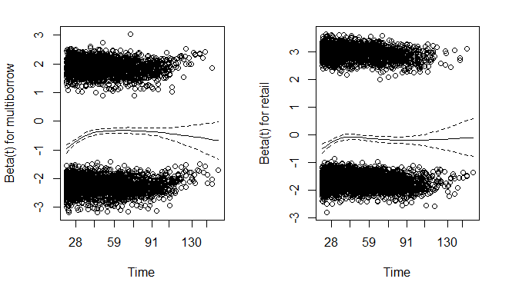
Model 2 Results (Cont.)
Multiple Borrowers flag, Retail Channel flag also violate PH

Slide 19
Model 3 Results
Removed Occupancy Status from Model
Stratified on Multiple Borrowers, Retail Channel flags
Difference of Interest Rate (Personal – Prevailing) improves fit and interpretability
Does not violate proportional hazards assumption

Slide 20
Model 3 Coefficients
Variable | coef | exp(coef) | se(coef) | z | Pr(>|z|)
unempdiff | 0.323778 | 1.38234 | 0.012352 | 26.212 | < 2e-16 | ***
hpistatediff | -0.01805 | 0.982115 | 0.000465 | -38.857 | < 2e-16 | ***
lfpdiff | 0.422498 | 1.525769 | 0.027256 | 15.501 | < 2e-16 | ***
scale(intdiff) | 0.280551 | 1.323859 | 0.01315 | 21.336 | < 2e-16 | ***
scale(fico) | -0.52941 | 0.588955 | 0.013731 | -38.557 | < 2e-16 | ***
unitcnt | 0.236214 | 1.266445 | 0.054269 | 4.353 | 1.35E-05 | ***
scale(cltv) | 0.567403 | 1.763681 | 0.020389 | 27.829 | < 2e-16 | ***
scale(dti) | 0.222919 | 1.24972 | 0.014263 | 15.63 | < 2e-16 | ***
refic | 0.566277 | 1.761697 | 0.03608 | 15.695 | < 2e-16 | ***
refin | 0.47209 | 1.603342 | 0.037204 | 12.689 | < 2e-16 | ***

Slide 21
Validation
Training and Validation sets both ~1% of source data
Method: Build Model 3 with both sets – Compare Coefficients
Table shown is Relative change – As a Percentage of Original Coefficient
unempdiff | hpistatediff | lfpdiff | scale(intdiff) | scale(fico)
0.088228 | 0.069906 | 0.098183 | 0.040799 | 0.024128
unitcnt | scale(cltv) | scale(dti) | refic | refin
0.550037 | 0.034792 | 0.04351 | 0.143707 | 0.144343

Slide 22
Final Model Results
Removed Unit Count from Model
Based Coefficient Estimates on Combined Dataset
Training and Validation
2% of data available

Slide 23
Final Model
Variable | coef | exp(coef) | se(coef) | z | Pr(>|z|)
unempdiff | 0.313525 | 1.36824 | 0.008059 | 38.9 | <2e-16 | ***
hpistatediff | -0.01847 | 0.981697 | 0.000308 | -59.9 | <2e-16 | ***
lfpdiff | 0.404531 | 1.4986 | 0.017942 | 22.55 | <2e-16 | ***
scale(intdiff) | 0.294053 | 1.341856 | 0.00866 | 33.96 | <2e-16 | ***
scale(fico) | -0.52491 | 0.59161 | 0.008981 | -58.45 | <2e-16 | ***
scale(cltv) | 0.544898 | 1.724433 | 0.01301 | 4.19E+01 | <2e-16 | ***
scale(dti) | 0.237465 | 1.268031 | 0.009536 | 24.9 | <2e-16 | ***
refic | 0.50781 | 1.661648 | 0.023851 | 21.29 | <2e-16 | ***
refin | 0.396258 | 1.486252 | 0.024131 | 16.42 | <2e-16 | ***

Slide 24
Going Forward
CLTV – Combined Loan to Value
Massive spike in CLTV at 80% - the cutoff between low CLTV and high CLTV for Freddie Mac – Investigate Reasons?
More work to abstract away from Economic Indicators
Interaction between Unemployment and LFPR?
Build Models on time-limited subsets of data to attempt to predict future loan performance
Build and Compare models on Cohorts within the data

Slide 25
Sources
Freddie Mac Single Loan Level Dataset
http://www.freddiemac.com/news/finance/sf_loanlevel_dataset.html
Freddie Mac Mortgage Rate Dataset
http://www.freddiemac.com/pmms/pmms30.htm
Freddie Mac Housing Price Index Dataset
http://www.freddiemac.com/finance/fmhpi/
Bureau of Labor Statistics (LFP, Unemployment)
http://www.bls.gov/data/

